Slide 1
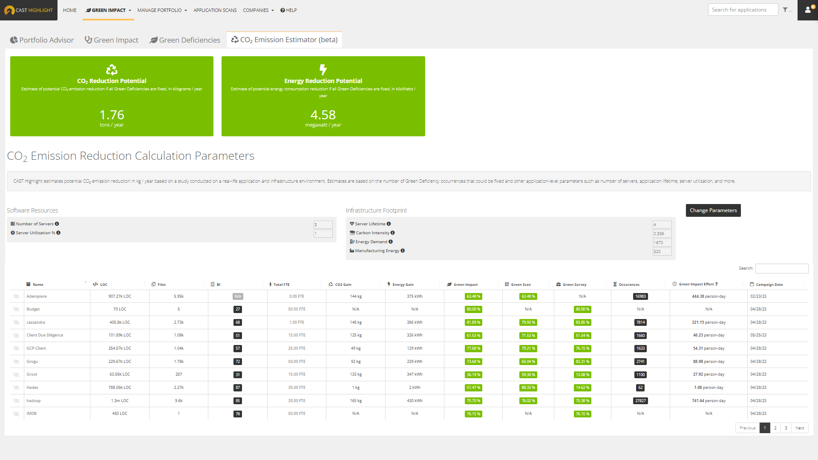
CAST Highlight CO₂ Emission Estimator (beta)
February 2024

Slide 2
Contents
Overview
Summary of the CO₂ emission reduction study
Formula for estimating potential CO₂ emission reduction
Formula parameters
Formula illustration
CO₂ Emission Estimator product capability
Current constraints
The path forward

Slide 3
Overview
CAST Research Labs conducted a study to understand the impact on CO₂ emissions and energy consumption when removing green deficiencies automatically detected by CAST Highlight from the code of a custom software application.
The results of the study were used to develop an initial formula for estimating the potential CO₂ emissions reduction and build it into CAST Highlight.
The formula is the basis of the new CAST Highlight CO₂ Emissions Estimator dashboard that was released in beta in Winter 2024.
This document includes more detail on this new capability, the underlying formula it leverages, and how it was developed.

Slide 4
Summary of CO₂ Emissions Reduction Study
CAST Research Labs conducted a study to understand the impact on CO₂ emissions and energy consumption when removing green deficiencies from the source code of a custom software application.
Here is an abridged summary of the steps in the study:
The application was analyzed by CAST Highlight to identify all green deficiencies.
The application was operated on the cloud and key application functions were executed thousands of times using automated tools.
The execution duration of the functions was measured using available diagnostic tools on the cloud platform to create a baseline.
A selection of ten (10) green deficiencies related to these application functions were then remediated with a more efficient coding method. The remediation process took an estimated four person days of effort.
The execution duration was then measured again for the “greener” version of the application and there was a ~5% improvement in the duration.
These results were used to develop a formula for estimating the potential improvements in CO₂ emissions and energy consumption that could be experienced for any application.
The formula was then built into CAST Highlight and released in beta since it is based on a small sample size and will be refined over time when additional results are available.

Slide 5
Formula for estimating potential CO₂ emission reduction
$${CO}_{2}eq emission reduction=\frac{n_{GD}}{MLOC}.f.\left(n_{server}. ts\right) \left(\frac{e_{manufacturing}}{lifetime}+ ed . CI\right)$$
Number of green deficiencies per MLOC
Experimental reduction factor
Software activity
Resource footprint

Slide 6
Formula Parameters
Parameter | Description | Source
n_{GD} | Number of green deficiencies detected | Automatically calculated by CAST Highlight
MLOC | Millions of lines of code | Automatically calculated by CAST Highlight
f | The factor to calculate potential reductions if green deficiencies are fixed as observed in the study conducted by CAST Research Labs | Fixed value: 0.004 %.MLOC/deficiencies
n_{server} | Number of servers that the application utilizes to operate | User supplied (default = 3)
ts | The time sharing or percent utilization of the server resource capacity | User supplied (default = 100%)
e_{manufacturing} | The CO_{2eq} emissions during manufacturing of servers | User supplied (default = 320 kgCO_{2eq} for a DELL PowerEdge R640)
lifetime | The expected lifetime of the servers in years | User supplied (default = 4)
ed | The annual energy demand for each server | User supplied (default = 1670 kWh/year for a DELL PowerEdge R640)
CI | The carbon intensity of the environment where the application is running | User supplied (default = 0.336 kgCO₂/kWh for North America)

Slide 7
Formula Illustration
Using results from the CAST study with the following parameters:
282.42 kLOC => 0.28242 MLOC
n_{GD} : 1676 green deficiencies
CI: 0.336 kgCO_{2eq} per server per year in North America region
ed: 1670 kWh per year
e_{manufacturing}: 320 kgCO_{2eq}
l: 4 years
n_{server}: 3 DELL PowerEdge R640 equivalent
ts: exclusive use 100%
Calculated results:
Potential Emission Reduction: 404 kgCO_{2eq} per year or 1.1 kgCO_{2eq} per day

Slide 8
How is the formula related to the Green Software Foundation’s SCI?
CAST utilized the GSF’s Software Carbon Intensity (SCI) formula as a basis for our calculations.
SCI = ( O + M ) / R
O operational emissions
M embodied emissions
R functional unit
O = ( E x I )
E energy consumed
I location-based marginal carbon intensity
M = TE x TS x RS
TE total embodied emissions, across the whole lifecycle of the resource
TS time-share, in case the resource is not allocated to the software 100% of the time
RS resource-share, in case the resource is shared with other pieces of software
R = the entire application in the CAST implementation
Note: the GSF has submitted the Software Carbon Intensity (SCI) formula to ISO with expected approval as a standard in 2024.
O is represented by the n_{server}, ts, ed, CI parameters in CAST’s implementation
M is represented by the n_{server}, ts, e_{manufacturing}, lifetime parameters in CAST’s implementation

Slide 9
CO₂ Emission Estimator (beta) available within CAST Highlight
Get estimates on the potential reduction in CO₂ emissions and energy consumption if Green Deficiencies are fixed in applications
Initial beta release in Winter 2024 based on internal CAST study results
Estimate calculations are based on a combination of automatically generated insights and user-configurable parameters such as the number of servers, server utilization, energy demand, and more

Slide 10
Current Constraints and Limitations
The CO₂ Emissions Estimator is released in beta form due to the following constraints and limitations (to name a few):
The formula is based on a single application study and one round of remediation
All green deficiencies are weighted equally in terms of potential reduction impact
The default values for parameters such as server choices, region, etc. could be quite different than a given organization’s specific situation, so users will need to know their corresponding values for more accurate estimates
The potential reduction in CO₂ emissions and energy is only realized if the newly available resources are used for some other operation or productivity

Slide 11
The path forward
Gather feedback from clients and partners during the beta release to enhance the product capability
Work with partners and clients to perform additional studies for refining the formula parameters
Develop real-world case studies that can be shared publicly

